Slide 1
Design Principles for Reusable, Composable and Extensible Frameworks
Jilles van Gurp

Slide 2
Thanks
Axis Communications: Torbjörn Söderberg, Per Flock
Ericsson Mobile Applications Lab: Magnus Oestvall
Jan Bosch (supervisor), Jelte Jansons (Opponent)
Jan Mark de Haan, Matthew Kenrick, Jeroen Kolner for proofreading

Slide 3
Contents
Introduction
Composition & Evolution
Communication Protocols
Enhanced State Pattern
Evaluation & Results

Slide 4
Introduction
Framework: a partial design and implementation for an application in a given domain.
Framework Composition: Multiple frameworks are used in an application
Framework Evolution: Changes that are made to a framework during its ‘Life’

Slide 5
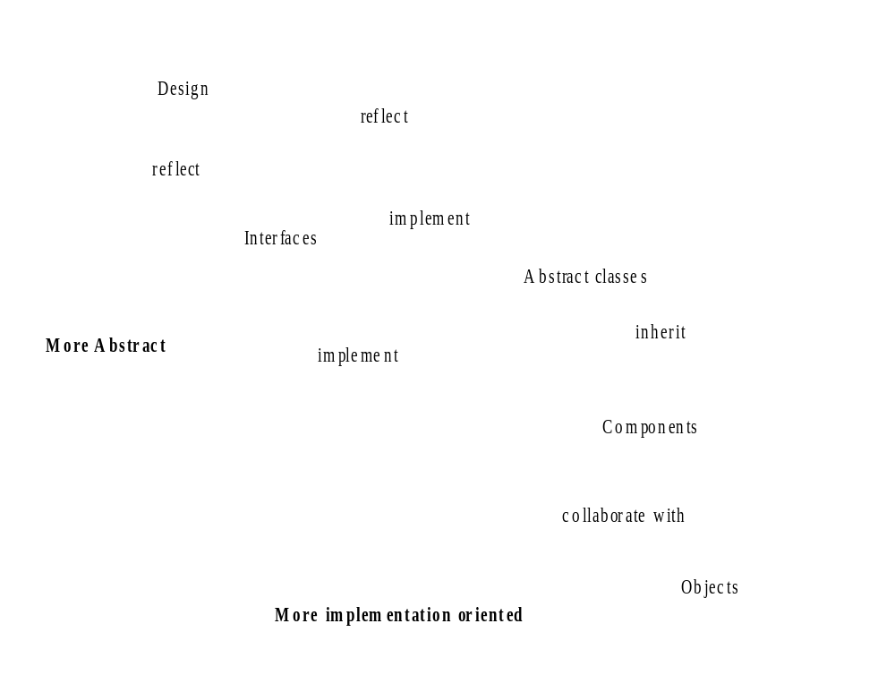
Framework

Slide 6
Problems
Applications depend on a framework ⇒ changing the framework affects applications
Frameworks make assumptions about the applications they’re used in ⇒ these assumptions clash if more than one FW is used.

Slide 7
Research question
How can Frameworks be designed in such a way that composition and evolution problems are prevented.
How can frameworks in the domain of communication protocols be designed in such a way that evolution and composition problems are prevented

Slide 8
Methodology
Analysis: how should frameworks in general be developed ⇒ a set of guidelines
Analysis of communication protocols ⇒ problems
A solution for problems in communication protocol frameworks
Evaluation

Slide 9
Frameworks
Whitebox Frameworks
  interfaces
  abstract classes
Blackbox Frameworks
  components

Slide 10
Composition Problems
Two frameworks assume to be in control of the application
Overlap in functionality
Gap in functionality
Framework has to work with legacy component

Slide 11
Evolution Problems
The framework will change over time
  Applications have to change too
  Framework design is endangered
Frameworks are often complex
  Hard to change
  Hard to use

Slide 12
Evolution problems (2)
Frameworks often have poor documentation
Frameworks have implicit usage rules

Slide 13
Consequences
Change is avoided (to protect existing applications)
Framework is used in the wrong way (resulting in errors, more maintenance work)
Internal framework structure erodes over time

Slide 14
Guidelines
18 guidelines
Four categories
  Process
  Design
  Component
  Implementation

Slide 15
Important guidelines
Don’t put too much functionality in a FW, specialise the framework.
Try too achieve loose coupling between components
Make blackbox configuration easy

Slide 16
Communication Protocols
Examples: IP, TCP, FTP, HTTP
Work together in Protocol Stack

Slide 17
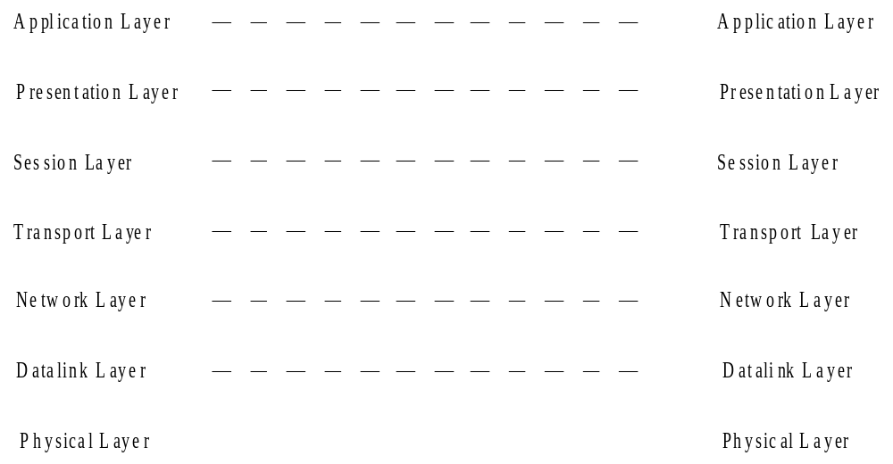
ISO OSI

Slide 18
Protocol Frameworks
x-kernel
Conduits/Conduits +/Java Conduits
Axis’ Network Protocol Framework

Slide 19
x-kernel
Object based, implemented in C
High modularity
High performance

Slide 20
Axis Network Protocol Framework
Based on conduits and own frameworks
Trades flexibility for performance

Slide 21
Conduits
Object Oriented
Very flexible (partly because of the extensive use of design patterns)
Conduit: a natural or artificial channel through which something (as a fluid) is conveyed (Webster)

Slide 22
Plumbing
4 types of Conduits
  Adaptor
  Protocol/Session
  Mux
  Conduit Factory

Slide 23
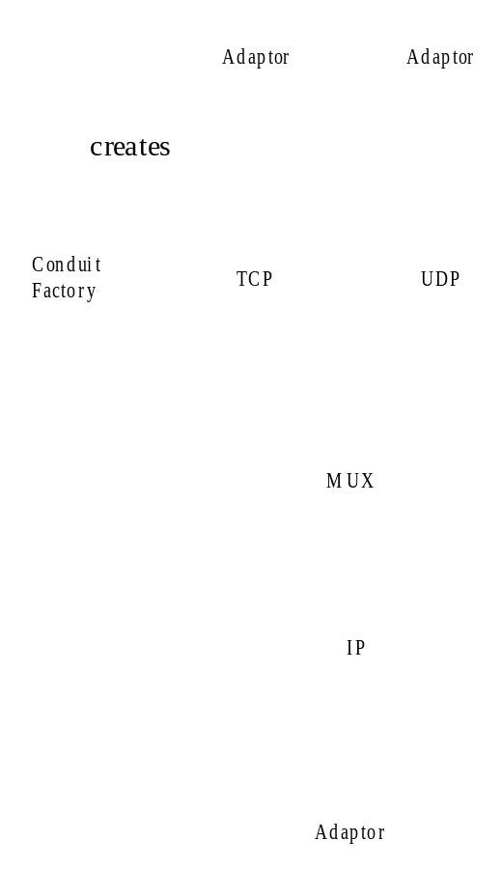
A Conduit graph

Slide 24
Benefits of Conduits
Blackbox protocol stack configuration
Highly object oriented
Automated data transport through stack
Session management
Scalable through the use of threads

Slide 25
Disadvantages
Does not support building protocols very much
Object orientation has a performance price

Slide 26
Conduits & guidelines
Conduits addresses two domains
  protocol stack configuration
  protocol implementation
Loose coupling
Blackbox configuration

Slide 27
Implementing a Protocol
Protocols can be represented as Finite State Machines
Conduits provides the State Pattern to implement protocols

Slide 28
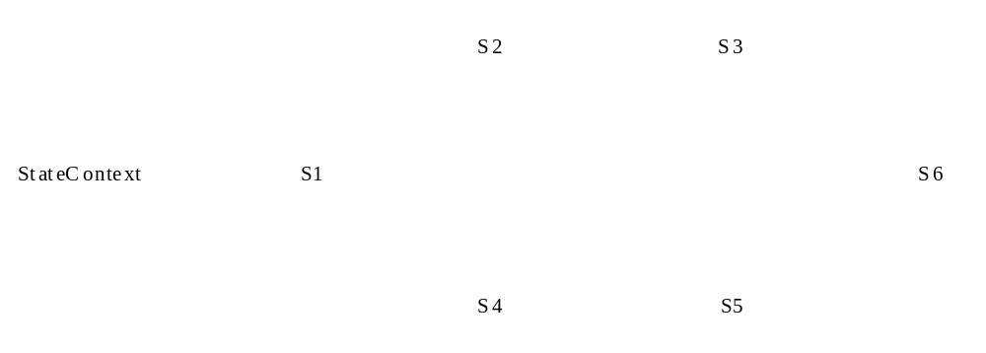
State Pattern
a state machine

Slide 29
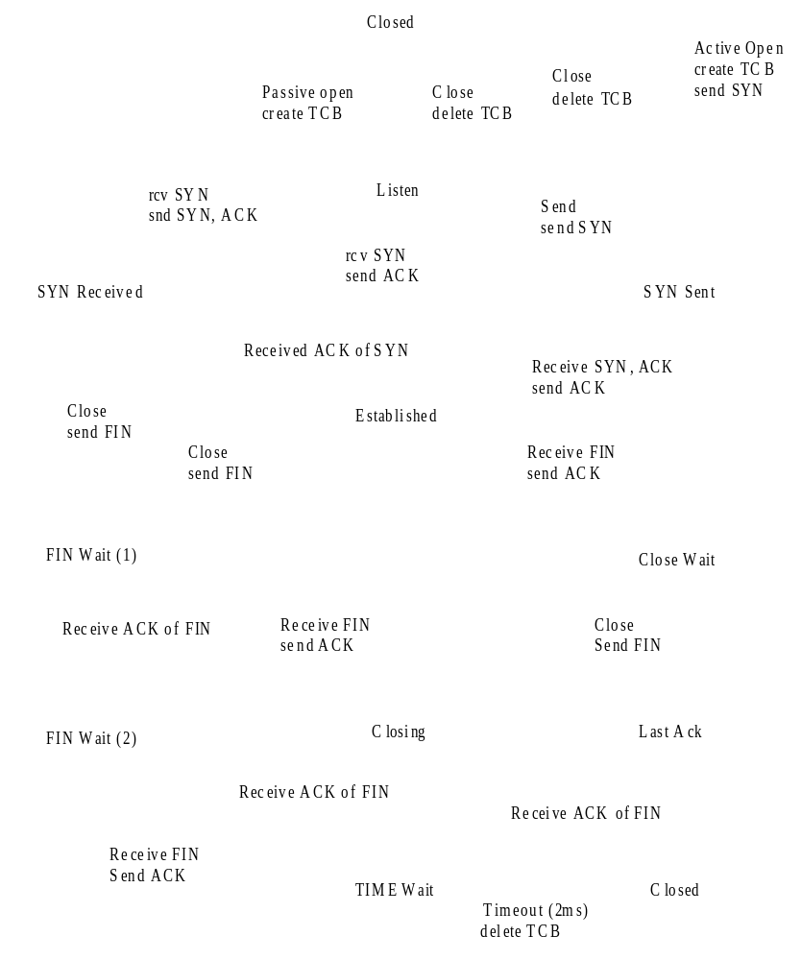
An example

Slide 30
Problems with the state pattern
Complex implementation
Hard to maintain implementations

Slide 31
Possible causes
State pattern does not support all FSM concepts (states, input/output events, transitions, behavior)
  states, transitions, events and behavior are put in a single State class
No blackbox way of building a FSM
  you have to inherit from base classes

Slide 32
Finite State Machine Instantiation
Necessary when the same FW is needed more than once in a system
Example:
  TCP can have thousands of connections at the same time.
  Each connection has it’s own FSM
Not all objects have to be replicated

Slide 33
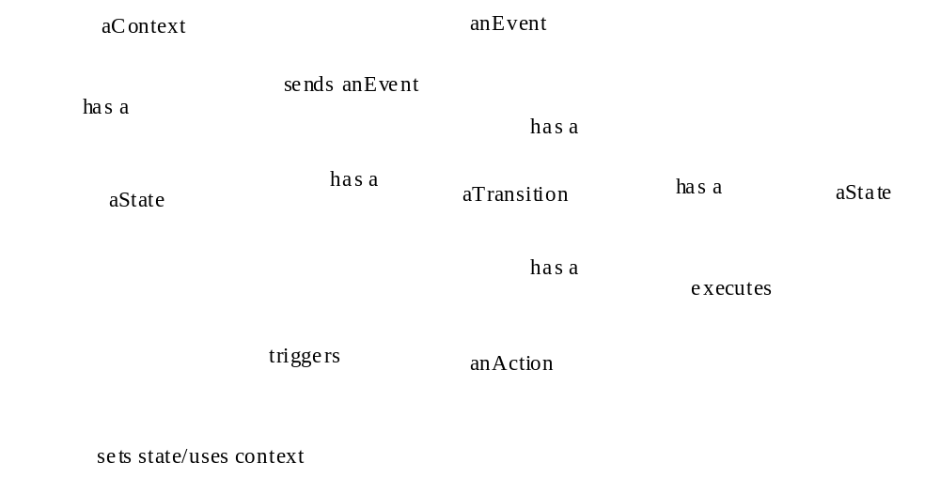
An alternative solution

Slide 34
An example
Context
E
S
S
T
A

Slide 35
Advantages
Blackbox configuration
More support for FSM concepts
Easier to maintain
More reuse possibilities

Slide 36
Implementation
Blackbox framework for FSMs
  object representation of FSM concepts
Configuration tool
  uses xml specification
  separates behavior from control flow.

Slide 37
Results
Guidelines
Analysis of existing frameworks
Enhanced State Pattern
Implementation
Small Evaluation of guideline usage and effectiveness in implementation

